Slide 1
Traffic Light Detection
Based on Machine Learning

Slide 2
GROUP MEMBERS
Group No. 20
Name | Roll No.
Suman Kalyan Das | 23
Varsha Kumari | 38

Slide 3
MENTOR
-Aditi Bal (AB)

Slide 4
INTRODUCTION
In this fast-moving digital world, autonomous cars will be a norm in near future. One of the most critical features of any autonomous car is traffic light detection and recognition.
Autonomous cars should be capable of detecting traffic signal and recognizing its current states(red, amber, green)

Slide 5
OBJECTIVE
The Objective is to identify the status of traffic lights and make decisions quickly according to the identified status of traffic lights. This can reduce driver distraction and prevent the occurrence of non-standard driving and illegal behavior.
We need to compare and contrast the feasibility and overall performances of the different approaches and thus figure out the best suited algorithm among the ones tested for satisfactorily precise Traffic light Detection.

Slide 6
Tools and Libraries Required
Python
VS code
Anaconda Navigator
Cascade Trainer GUI
Numpy
Pandas
OpenCv

Slide 7
Approach
Two parts of our project
Detecting Traffic Signal
Recognizing Traffic light Color
A camera mounted on the windshield inside the car will capture the images in real time and to avoid any other vehicles back lights or headlights, the camera will be placed in such a way that it will only capture the upper part of the view.

Slide 8
Approach
For detecting traffic signal, we are using Haar Cascade algorithm. The camera will continuously capture the images and when traffic light signal will appear, using this algorithm that traffic signal will be detected.
After detecting traffic signal, it will be cropped and will be saved in a folder as jpeg file and from there, the cropped image will be taken to detect its current state.

Slide 9
Continued…
For detecting traffic light color, we are using opencv module of machine learning.
Using this, traffic light color will be detected and recognised and a text will appear accordingly
if it is red- stop will appear in text
if it is amber- Get Ready will appear in text and
if it is green - Go will appear in text.

Slide 10
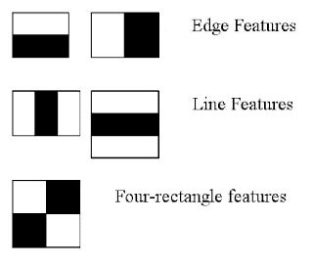
Haar Cascade
Haar Cascade classifiers are an effective way for object detection. This method was proposed by Paul Viola and Michael Jones in their paper Rapid Object Detection using a Boosted Cascade of Simple Features .Haar Cascade is a machine learning-based approach where a lot of positive and negative images are used to train the classifier.
Positive images – These images contain the images which we want our classifier to identify.
Negative Images – Images of everything else, which do not contain the object we want to detect.

Slide 11
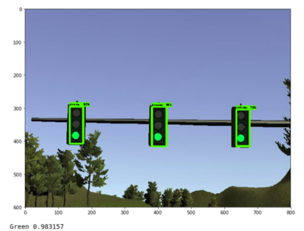
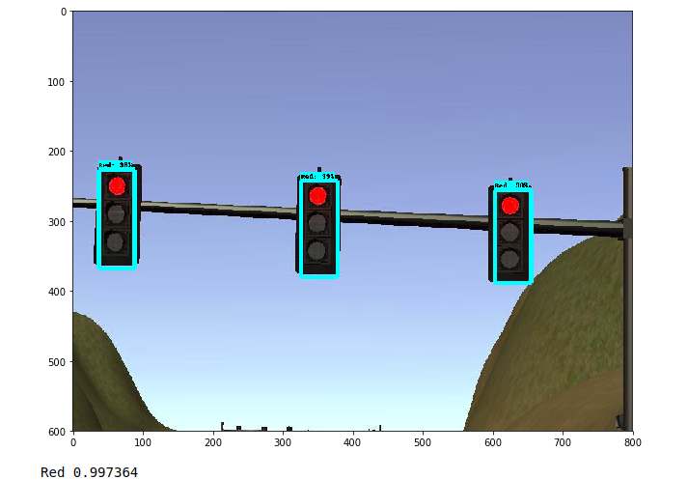
Detecting Traffic Lights from the images
.

Slide 12
To Recognize Traffic Light Color
The camera mounted on the windshield inside the autonomous car will capture the images of traffic lights which will be the datasets (input) to the open cv2 module.
The Python code uses an open cv2 module for color detection and the RGB (Red-Green-Blue) colors in the datasets will be converted into the equivalent HSV (Hue-Saturation-Value).

Slide 13
Continued…
Color range values are specified using an array for the respective colors.
Color range values are specified using an array for the respective colors.
Hough circles are used to draw circles around the detected color
Once the traffic light is detected and recognised a text is displayed on the output image
Red-Stop
Amber-Get ready
Green-Go

Slide 14
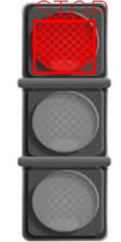
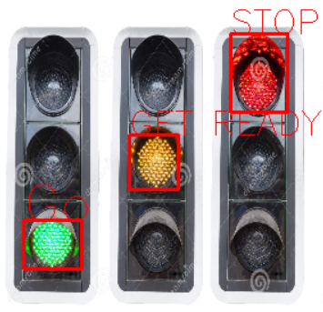
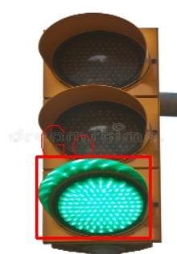
Some snaps of our code output

Slide 15
Future Scopes
Accuracy needs to be improved .
Also, in future we need to work also on false positive images like street lights, red colored road signs, or any other color reflection during night.

Slide 16
Conclusion
We tried to implement a new accurate strategies to detect traffic light in real time using haar cascade and it gave us a good output as well as successfully detected most of the objects (traffic light).
The accuracy of traffic light detection is approx 89% And color detection accuracy is approx 78%.
This algorithm gives correct output in day time but not aware of how will this work in night time under false reflections like tail lamps, street lights, red-colored road signs and other reflections.

Slide 17
Reference
OpenCV: Face Detection using Haar Cascades
Traffic Lights And AI Autonomous Cars - AI Trends
https://m.blog.naver.com/natalliea/222198638897
https://amin-ahmadi.com/cascade-trainer-gui/
https://medium.com/@vipulgote4/guide-to-make-custom-haar-cascade-xml-file-for-object-detection-with-opencv-6932e22c3f0e
https://towardsdatascience.com/viola-jones-algorithm-and-haar-cascade-classifier-ee3bfb19f7d8

Slide 18
..
Thank You

